Slide 1


Slide 2

Real-Time GPU Usage Alert Service on Pre-Exascale HPC Clusters
Songlin Jiang
A master’s thesis in collaboration with CSC - IT Center for Science
Co-supervised by Prof. Bo Zhao (Aalto), Prof. Bernd Dammann (DTU),
Dr. Sebastian von Alfthan (CSC), and Dr. Sami Ilvonen (CSC)
Notes:
Hi everyone! Welcome to my master's thesis presentation! My thesis is done at the CSC-IT Center for Science. The thesis is about designing a real-time GPU usage alert service on supercomputers.

Slide 3
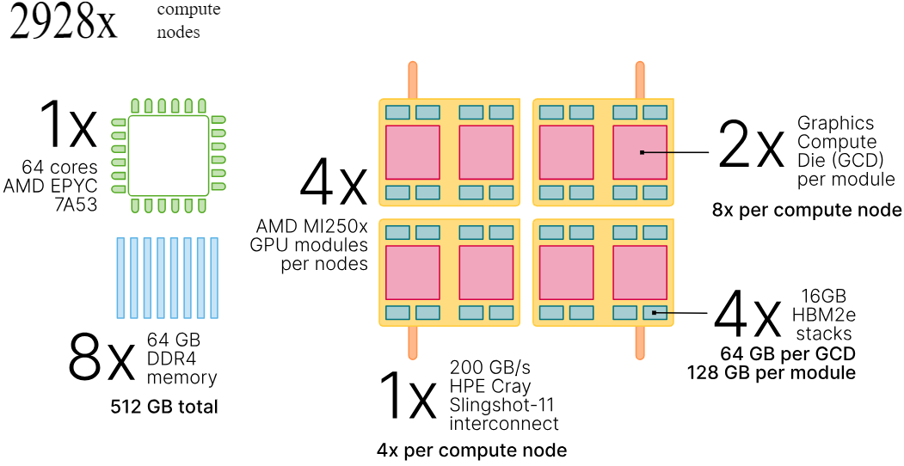
GPU nodes of CSC Supercomputers
GPU for HPC | Puhti [1] | Mahti [2] | LUMI [3]
Number of GPU nodes | 80 | 24 | 2928
GPU Model | Nvidia V100 | Nvidia A100 | AMD MI250X
GPU number per node | 4 | 4 | 4 / 8*
Total number of GPUs | 320 | 96 | 11712 / 23424*
Figure 1: LUMI GPU node details
* MI250x GPU is a multi-chip module (MCM) with two GPU dies named AMD Graphics Compute Die (GCD)
Table 1: GPU details for CSC HPC systems
Notes:
First, let’s have an overview of the GPU nodes in CSC supercomputer systems to get everyone started.
CSC runs three supercomputers: Puhti, Mahti and LUMI, while LUMI is the pre-exascale supercomputer we are targeting.
You can see the details of GPU nodes in the table. Puhti and Mahti use Nvidia GPU, while LUMI uses AMD GPU.
All the computing nodes have 4 GPUs, but we have an exception here for LUMI, since AMD GPU uses a multi-chip module with 2 GPU dies, so it counts as 8 GPUs when we allocate resources in the job scheduler. So, for the pre-exascale supercomputer like LUMI, our alert system's maximum number of possible jobs is around 20 thousand, which should be the maximum capacity we are targeting when designing.

Slide 4
Why alert service for GPU usage
GPU typically consumes the most power in the computing system
e.g., for the LUMI computing node:
CPU: AMD 3rd Gen EPYC, 64 cores
TDP (Thermal Design Power) range: 280W
4W per reservation (core)
GPU: AMD MI250X, 2 GCD
TDP range: 500W
250W per reservation (die)
Notes:
So why alert service only for GPU usage? GPU typically consumes the most power in the computing system. As you can see, the thermal design power for one CPU on LUMI is 280 watts, while it’s 500 watts for GPU. The workload manager gives out reservations of resources based on CPU cores, so it’s 4 watts for each CPU reservation, while workload manager gives out the whole GPU device for each reservation, so it will be 250 watts for each GPU reservation.
So, compared to CPU, misusing one reservation of GPU can cause more than 60 times of the resource waste. It will significantly improve energy efficiency if we spot and kill those jobs to keep the supercomputer running efficiently.
Also, if we choose to do alert for CPU as well, there are too many CPU cores to track; For LUMI, we have 2 million CPU cores while we only have 20 thousand GPU dies. It’s way more complicated to have a near real-time alert system for CPU cores in millions while keeping track of something in thousands is still manageable and easier.

Slide 5
Send loaded module information
Lmod
TimescaleDB
Start collecting data
(with fixed
interval)
Stop collecting
data
Trigger data ingestion when the MonServer buffer is full
Monitoring Server
API for fetching job usage data
Write to DB when ingestion buffer is full
Node
Cgroups, /proc, nvidia-ml, ROCm-libs (AMD)
Timescale Reader
Timescale Ingest
Job
Render graphs / table as of user requests
slurm
prolog
slurm
epilog
Monitoring Client
Seff / Timescale Chart
Check Usage
Tell MonServer job starts
Tell MonServer job ends
HPC User
Slurm prolog: Run before the job starts
Slurm epilog: Run after the job ends
Notes:
Now, let’s look at how our HPC monitoring system works, which was part of my work at CSC during my last summer internship.
Slurm is a top open-source workload manager in HPC, which is the workload manger we are targeting at. We have one instance of the monitoring server running in the background on each computing node. Before the job starts, the slurm prolog will start the monitoring client. The monitoring client will then send the job metadata to the monitoring server. Then, the monitoring server will begin collecting data at fixed intervals.
We have also configured a hook in Lmod to send module load information to the monitoring server.
After the job ends, Slurm Epilog will start the monitoring client again to notify the monitoring server that the job has been completed.
When the data buffer of the monitoring server is full, the monitoring server will send all the collected data to timescale ingest. Timescale ingest will write to timescaledb when the ingestion buffer is full.
TimescaleDB is a database based on PostgreSQL that is optimized for handling time-series data using hypertables.
The timescale reader reads data from the timescaleDB and Seff command or Timescale chart renders graphs or tables to users regarding specific jobs.

Slide 6
Alert Service
TimescaleDB
Polling/Triggers
Timescale Alert
Alert message
Logs / Report
Features:
Listen to job metadata table insertion for start/stop of jobs
Avoid memory leak by dropping jobs that stop sending new data, e.g., longer than 1 hour (can happen when jobs are killed due to OOM)
Aggregate as soon as new data have been inserted (in near real-time)
Dump the alert state regularly, serve a REST API for later dashboard integration (e.g. https://developer.apple.com/system-status/)
Notes:
For this thesis, the alert service we implemented is built on the monitoring system. For possible design choices, it communicates with the TimescaleDB through polling or triggers to update the internal state. Whenever we have a new alert, or the alert is dismissed, we write the event into logs.
We create or destroy the internal state for specific jobs by listening to job metadata updates. We do a garbage collection for stale jobs to avoid memory leaks. We also want to get the aggregation result as soon as data has been inserted and dump the alert state at regular intervals for dashboard integration.

Slide 7
Research Question
How do you systematically design the service to analyze jobs in HPC systems efficiently and reliably in real-time?
Sub-RQs, how to:
Minimize the alert delay in the real-time context
Minimize the performance impact on the database systems
Reliably maintain a data structure for job alert status check
Find out the most reliable algorithms for generating alerts
Notes:
Our research question for this project is, how do we systematically design the service so that we can efficiently and reliably analyze jobs in supercomputers in real time? This can be divided into several sub-research questions, such as how to minimize the real-time alert delay and the performance impact on the database. How to reliably maintain a data structure for alert state, and how to reliably find out jobs that are not efficient.

Slide 8
Techniques
For reliability, no message queue/broker is involved
No Apache Kafka/Pulsar
PostgreSQL: Triggers execute NOTIFY after insertion of each row, Timescale Alert LISTEN to the updates (works like MQs)
TimescaleDB Cagg: Materialized view, update based on scheduled interval tasks (like Continuous Processing in Spark Structured Streaming)
No sliding-window aggregation support in Cagg, Apache Spark/Flink
Notes:
To answer those research questions, here are some available techniques for us. Since message queues can easily go wrong and are hard to debug, according to people’s experience at CSC, we don't want to introduce message queues in our system. This increases the difficulty of our design, but luckily, we are using TimescaleDB, it’s based on PostgreSQL. PostgreSQL has LISTEN and NOTIFY, so we can use triggers to execute NOTIFY after the insertion of each row, and TimescaleAlert can LISTEN to the updates.
We also have continuous aggregates in TimescaleDB, which is based on the materialized view and works like continuous processing in Spark structured streaming. Spark and Flink can also be our choice. However, after investigation, I found that they don’t have sliding-window aggregation support.

Slide 9
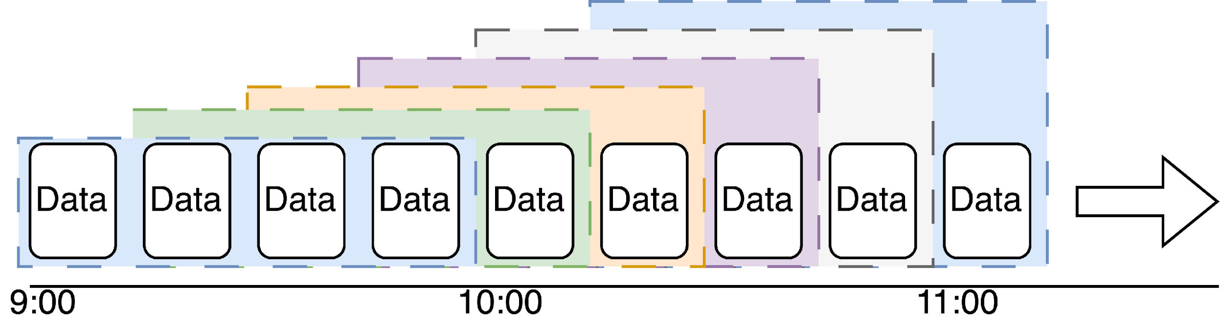
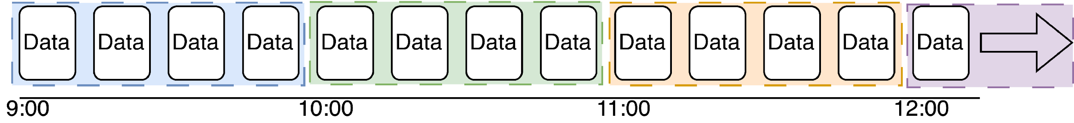
Sliding-window aggregation
What we want: sliding-window aggregation on the last 1 hour’s data
Cagg, Apache Spark/Flink offer: Aggregation with a fixed start time
It works poorly if we check the alert status at o’clock
Notes:
So what is sliding-window aggregation? Since we want real-time alerts, we want to aggregate with a fixed-size sliding window that considers the latest data and drops the old data at any time. However, TimescaleDB continuous aggregates, Spark, and Flink high-level API can only aggregate with a fixed start time, which will work badly if we want to check the latest aggregation result at, for example, 12 o’clock in this case since then we will only have one specific data in that window. Then, it isn't very sensible to have an aggregation since we are not actually doing any aggregation and it can fluctuate.
https://stackoverflow.com/questions/44536553/process-event-with-last-1-hour-1week-and-1-month-data-in-flink-streaming
https://stackoverflow.com/questions/40432800/flink-streaming-how-to-process-each-event-with-all-events-of-the-last-30-days

Slide 10
Empirical Analysis of Design
For data fetching, we can either choose polling or triggers
Polling involves querying via SQL. It might burden the database
heavily with floods of read operations at intervals
Triggers can be defined to happen after the insertion of each row. It might slow down the database speed for writing operations
We can also choose to use the Continuous aggregates (Cagg) in TimescaleDB
We might not need sliding-window (e.g., weighted average on last 2 windows)
Triggers in Cagg are not supported:
https://github.com/timescale/timescaledb/issues/6500
It might burden the database with a heavy background job workload
Notes:
Here is an empirical analysis of the possible design choices for the alert service. We can choose either polling or triggers. With polling, the alert delay increases and will likely burden the database heavily with read operations. The alert delay is minimized with triggers, but we might slow down the database for writing operations due to additional transactional overhead.
We can also use the continuous aggregates in TimescaleDB. Although the sliding window is not supported, we can overcome this issue by using a weighted average on the last 2 windows. However, it's still not a good candicate since triggers for continuous aggregates are not supported currently, as confirmed by the issue I opened. So we will have to burden the database by polling, which means many read operations plus many background jobs.
https://github.com/timescale/timescaledb/issues/2981

Slide 11
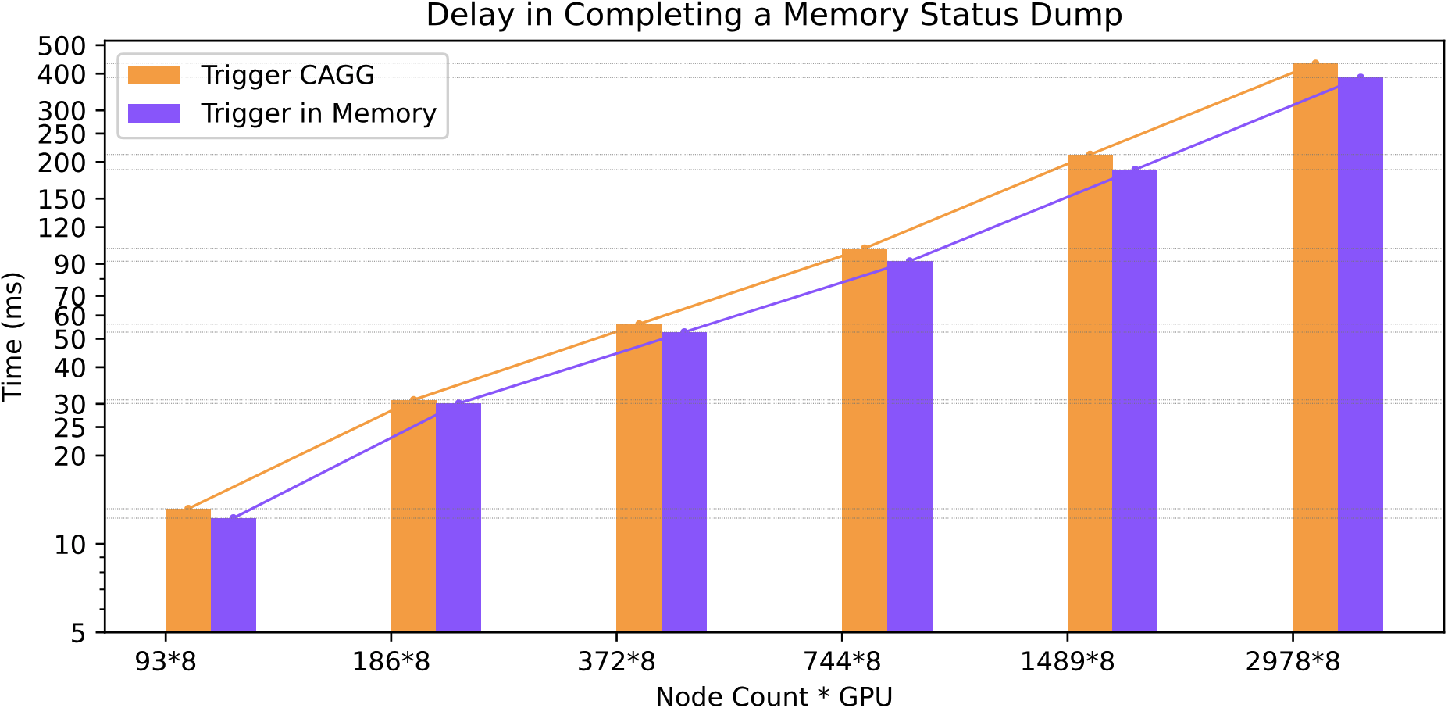
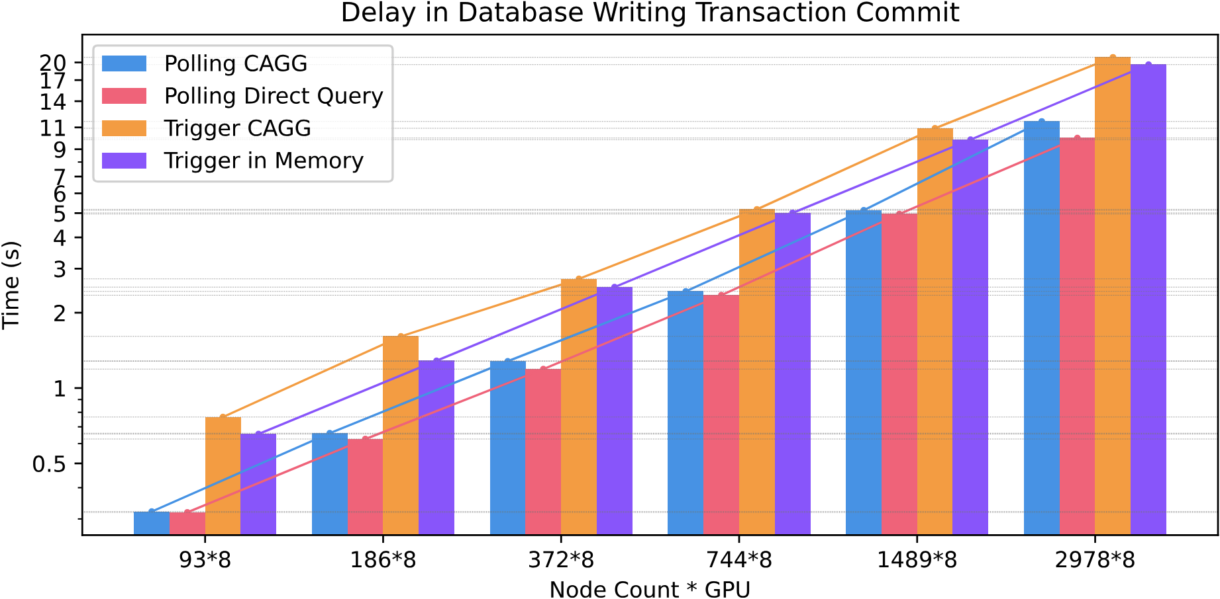
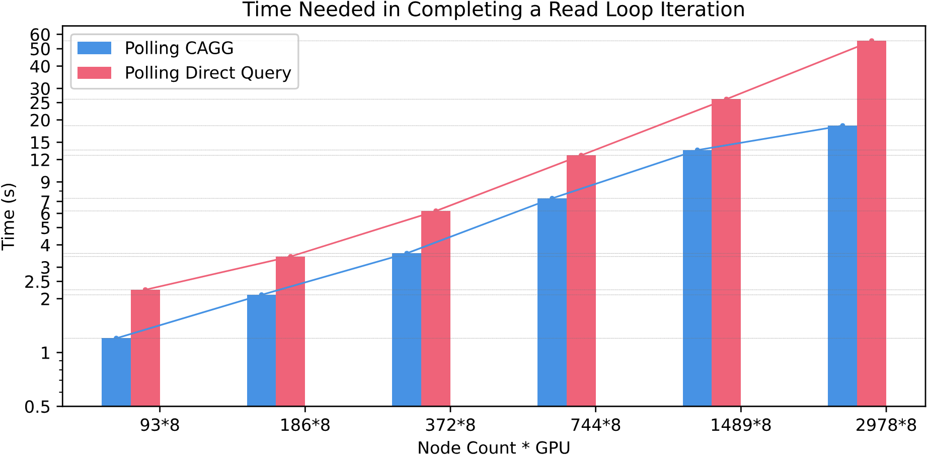
Benchmark Result
Notes:
Then I implemented the 4 solutions one by one, which is a combination of polling and triggers, as well as with and without continuous aggregates, and did benchmarks on those 4 programs. The benchmark graph is in log scale, from the graph, we can find that generally, all the delays scale linearly with the number of GPUs. Triggers generally double the delay in database transaction commit time for writing, which the overhead of NOTIFY should be the cause. Continuous aggregates (CAgg) cause a slight increase in writing delay and the memory status dump delay for the triggers solution, which is likely to be caused by the overhead of Continuous Aggregates background jobs. However, Continuous Aggregates accelerates the query speed dramatically compared to traditional SQL queries aggregate, as we can see a significant time reduction in completing a read loop among all the jobs available. Polling is very inefficient for accessing data in real-time, since it creates a delay that is almost 100 times more than the triggers solution.

Slide 12
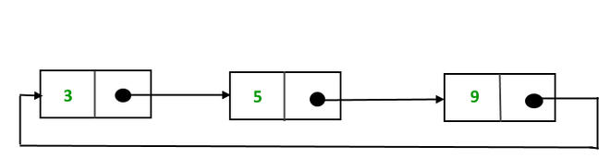
Final Solution: Triggers without Cagg
LISTEN to data sent by the NOTIFY from TimescaleDB, then update
Use container/ring (Circular Linked List) to store the history data
Data arrives in order with evenly distributed intervals
Pros: Have more control over the data to do other aggregations
Do more complicated statistics calculation
Use machine learning models
Cons: Data race can happen (be extremely careful)
sync.map, mutual exclusion (mutex) lock for internal state updates
Maximum Resident Set Size (RSS): around 84.6 MB
Notes:
So, the results confirmed my empirical analysis and led to the final design we used after comparison: triggers without continuous aggregates. Here, we listen to the metrics data sent by the notify from the database and update the internal state in memory. We use a fixed-size circular linked list as the sliding window to store the history data since our monitoring system can ensure that data arrives in order and has evenly distributed intervals. Also, this solution has one advantage compared to the others, as it allows us access to raw data to do more complicated statistics calculations and use machine learning models. But since we have to manage the internal state ourselves, the data race can easily happen. I tried to address this issue using the thread-safe map and mutual exclusion lock. I also used the Golang data race detector, which looks fine even after extensive tests. The maximum memory usage is also acceptable.

Slide 13
Alert algorithms
Alert only according to average is not reliable
Data might be highly fluctuated (load balancing on multiple GPUs)
Use machine learning models
Unsupervised reinforcement learning: Hard to train, interpret, and run slow. There is no good reward function, only from human feedback
Supervised (random forests): No available dataset to train (no label)
Use KMeans clustering and silhouette analysis: No good results
Notes:
Now, for the alert algorithms part, alert only according to average is not reliable at all since data are highly fluctuated for multiple GPU jobs, as a lot of high-performance computing applications have load balancing issues regarding pipeline parallelism on GPU usage, so it may not be the user’s fault at all. Machine learning models can be one way to address this issue, but unsupervised ones, such as reinforcement learning, are hard to train and interpret, and they are very slow to run. Most importantly, we can’t find a good reward function, and the only way seems to be from human feedback. For supervised ones, such as random forests that involve decision trees, since all the data collected from the monitoring system is unlabeled. It’s unrealistic to label all those millions of data manually by humans. I have also used silhouette analysis on K-means clustering on either time-series data or features generated with statistical aggregation, but it doesn’t work well.
https://medium.com/geekculture/time-series-classification-without-labels-4c3acc5cfd0f

Slide 14
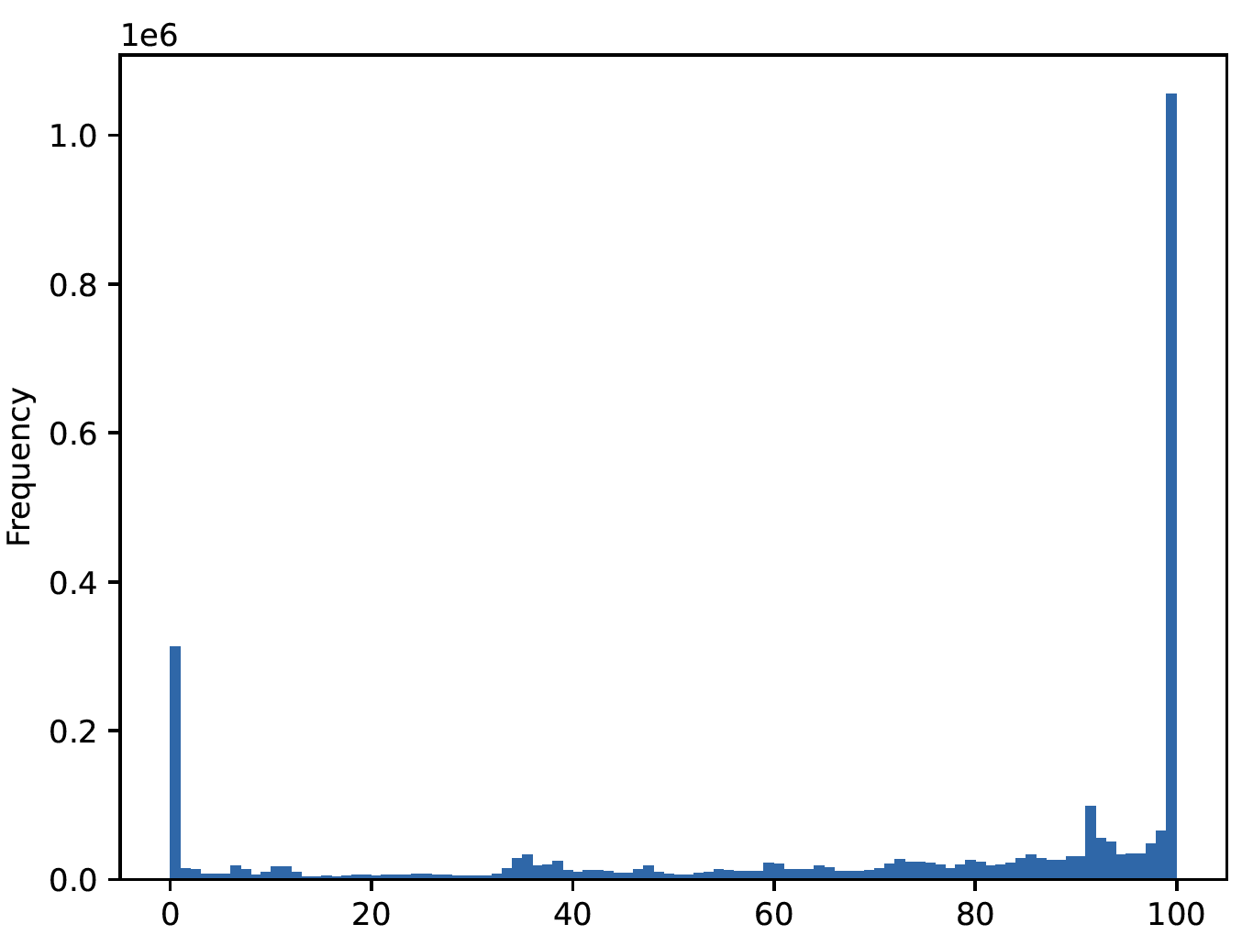
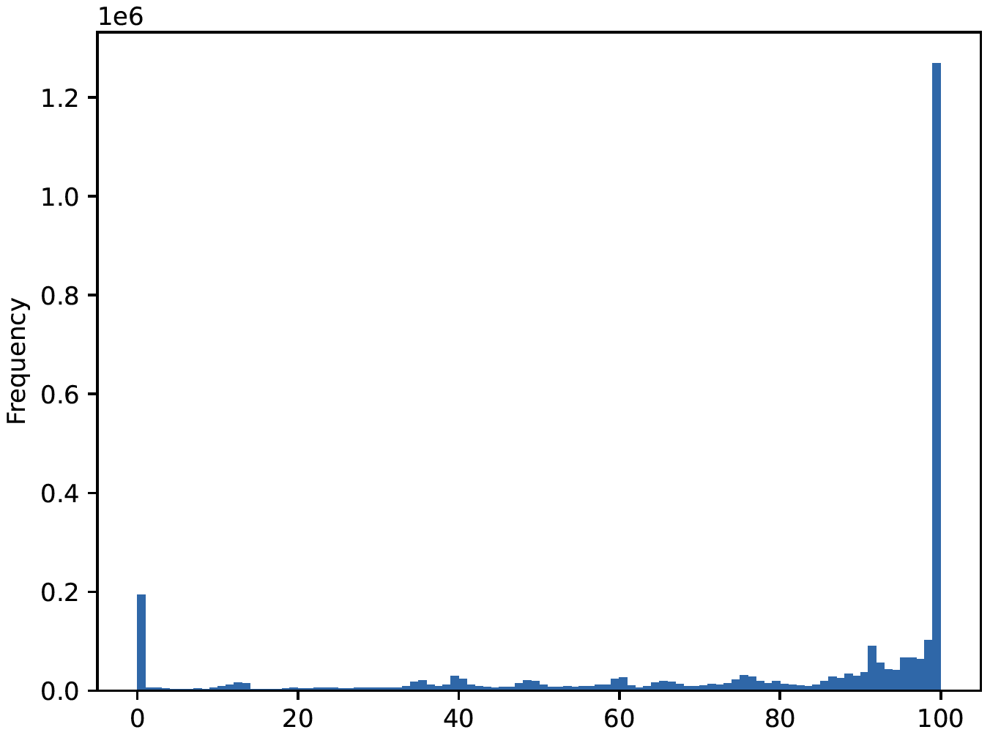
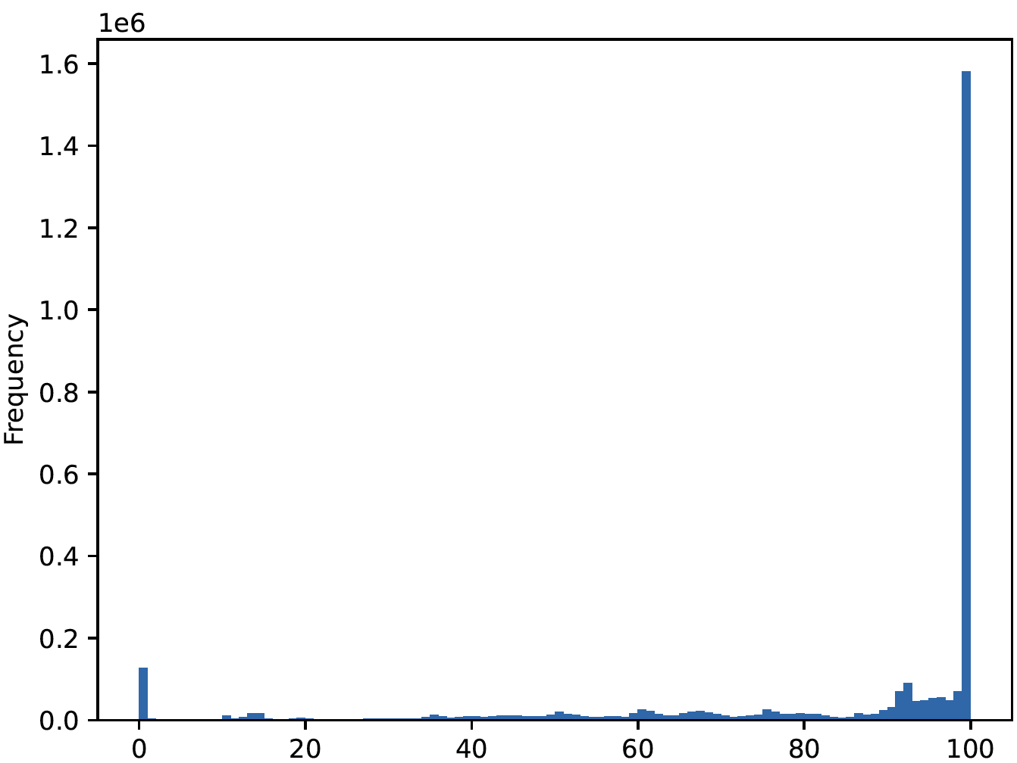
Alert algorithms
Use more descriptive statistics (75% < 20 || max < 32)
Dispersions: Variance, standard deviation, and interquartile range
Skewness and Kurtosis: asymmetry and peakedness of distribution
25%, 50%, 75% histogram, distribution graph based on the sliding window:
Notes:
So, we finally decided to use more descriptive statistics, such as percentiles, dispersion, and skewness, to aid alerting. These are the histogram based on the sliding window. Combined with the analysis of the monitoring data in production and the actual need for job alerting, which is to find out the bad jobs that can be greatly improved, we eventually fine-tuned and discovered that 20 in the 75th percentile
https://medium.com/geekculture/time-series-classification-without-labels-4c3acc5cfd0f

Slide 15
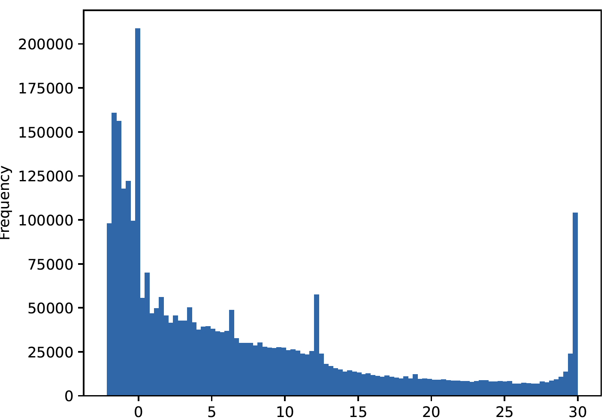
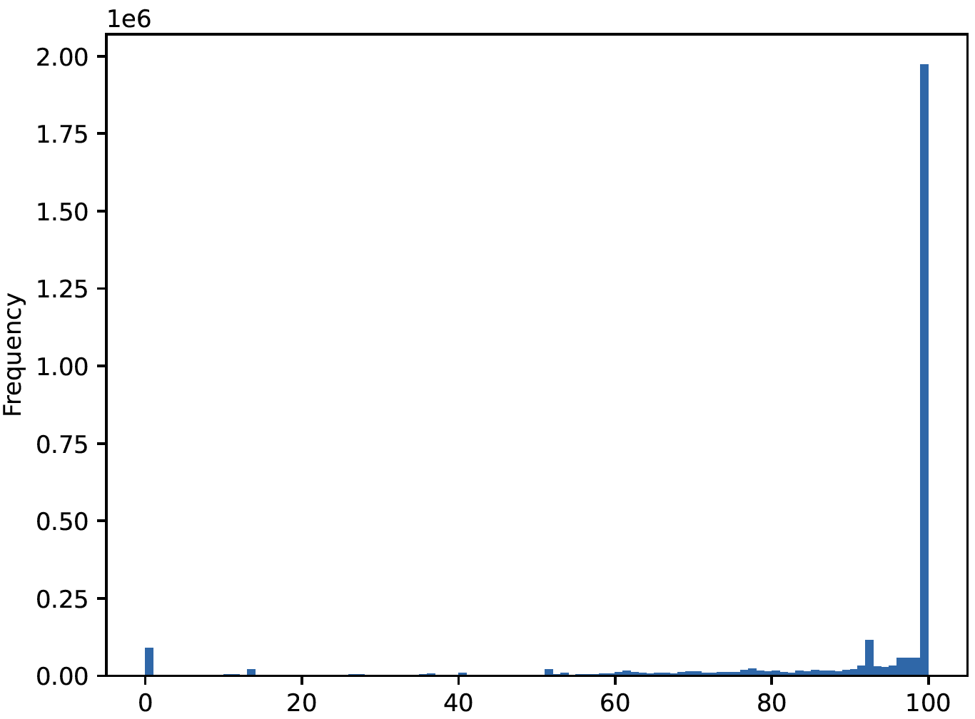
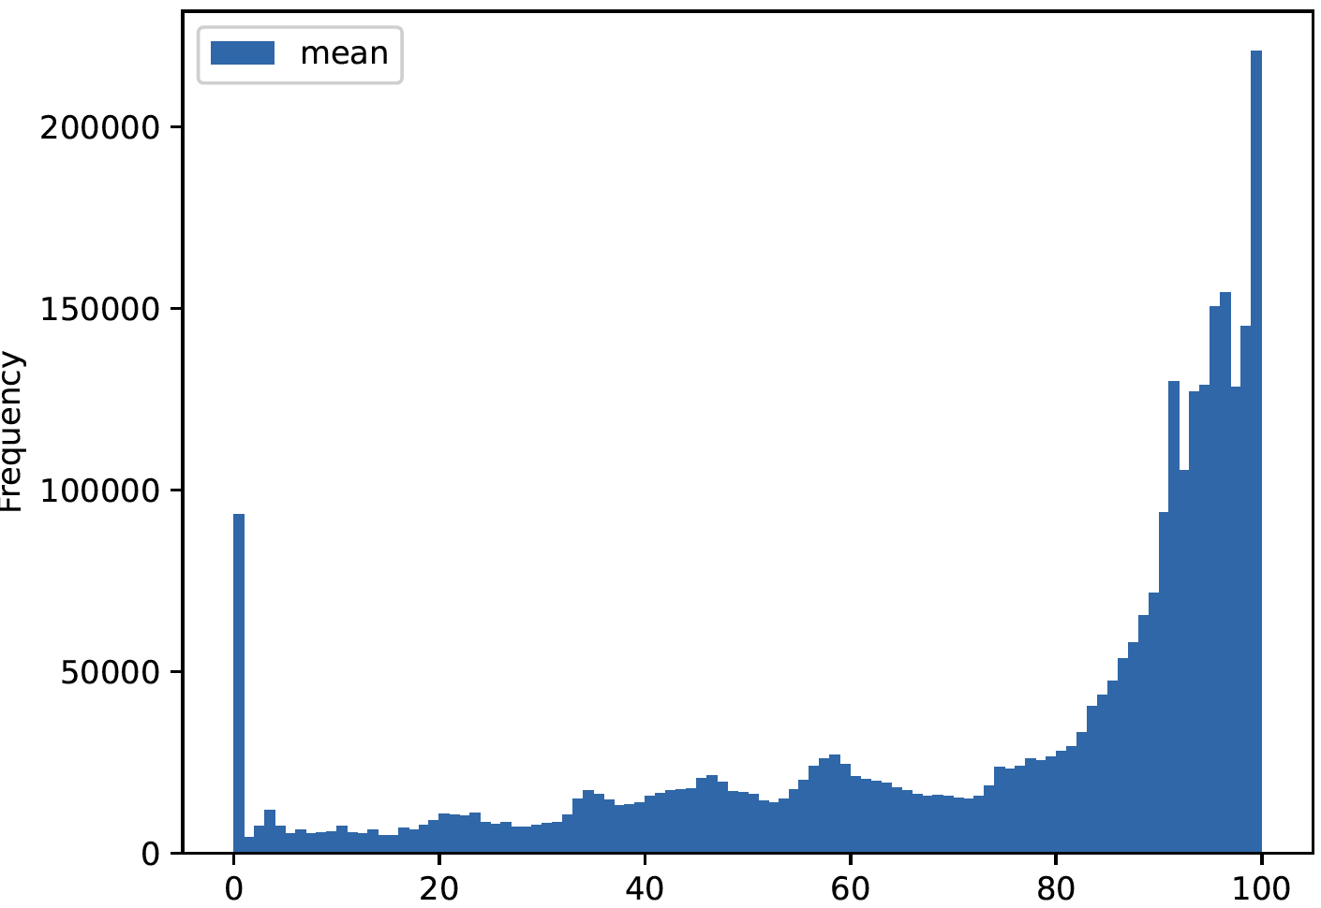
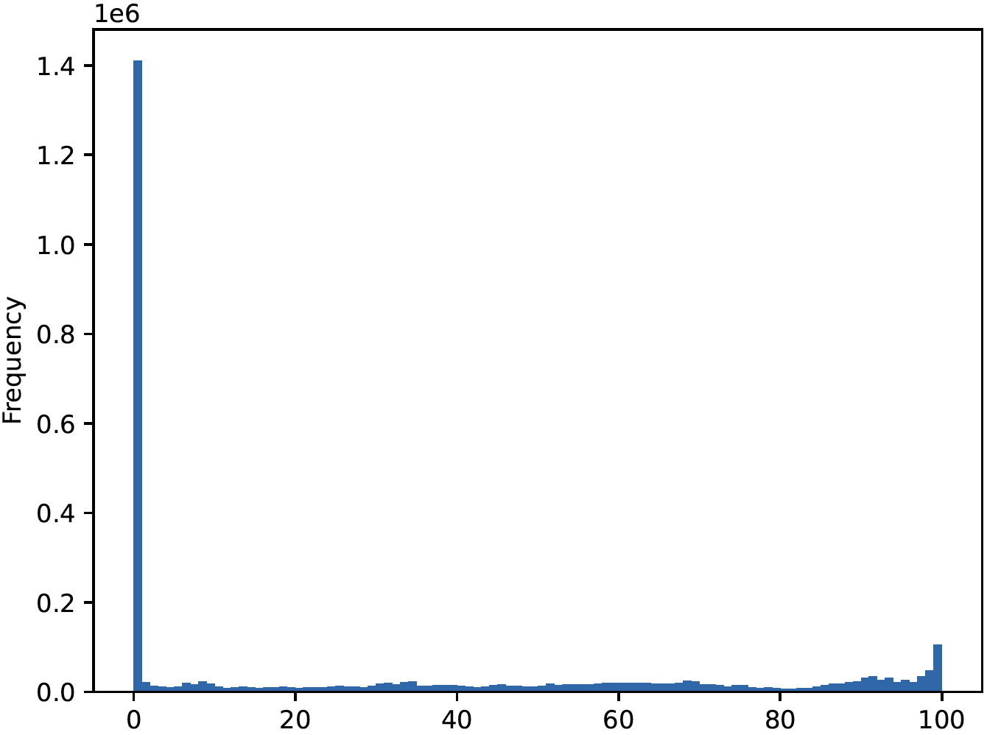
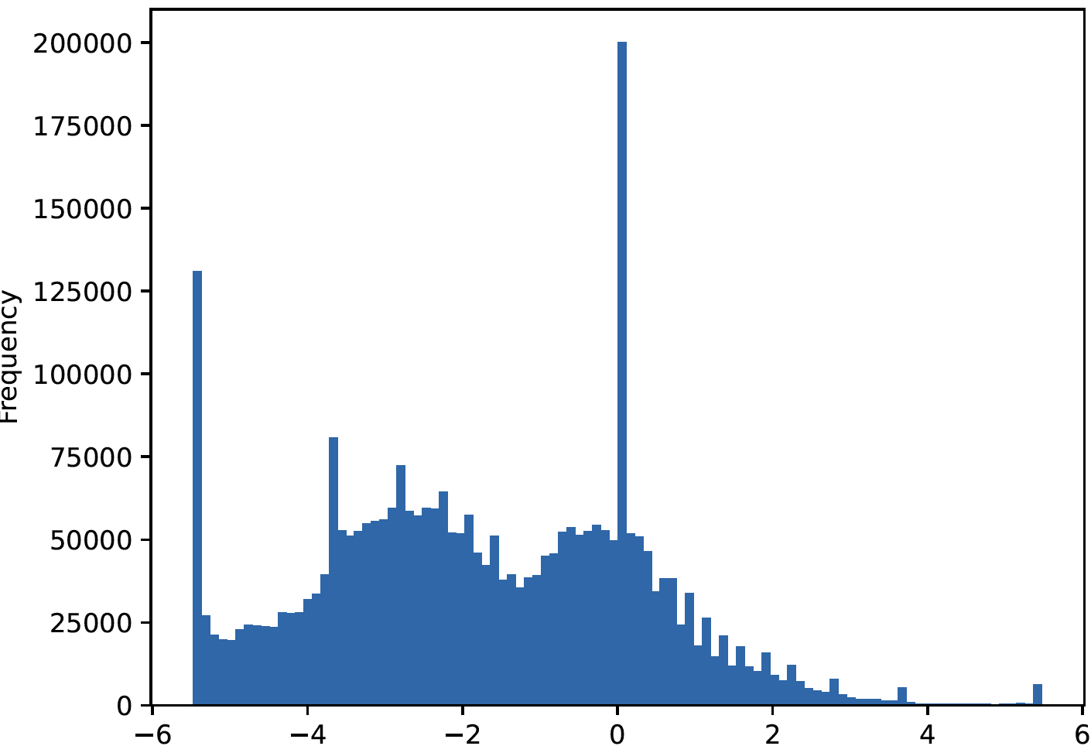
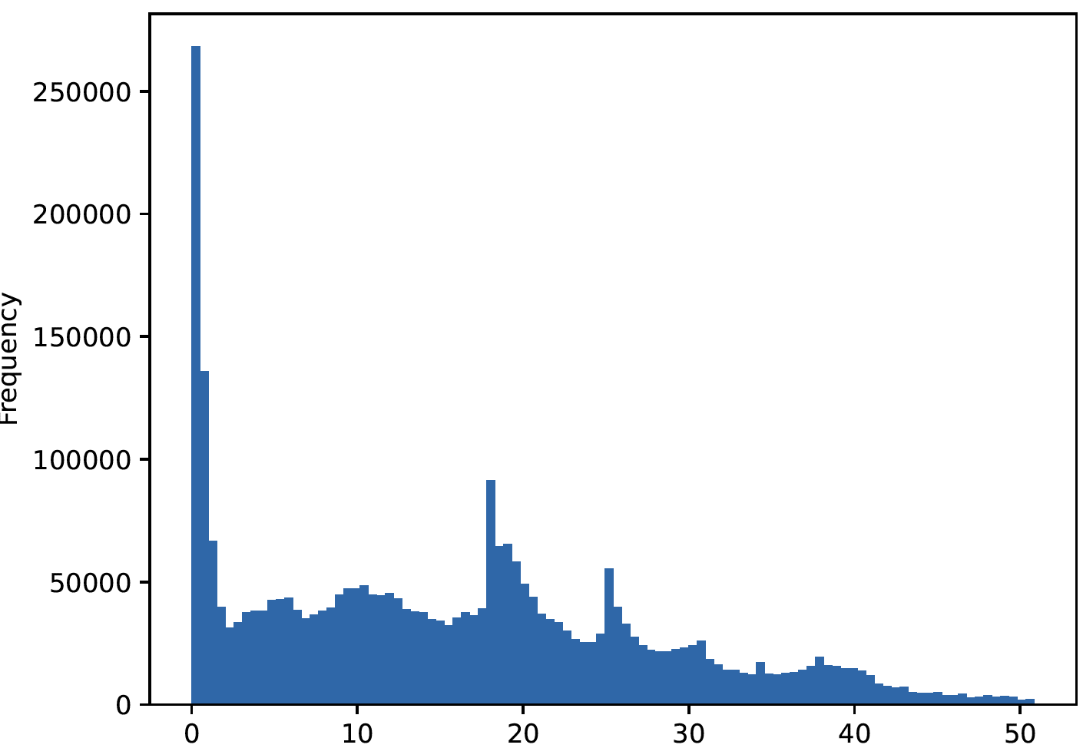
Alert algorithms
kurt, max, mean Histogram
min, skew, std Histogram
Notes:
and 32 in maximum are good separations

Slide 16
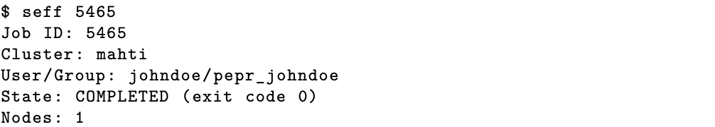
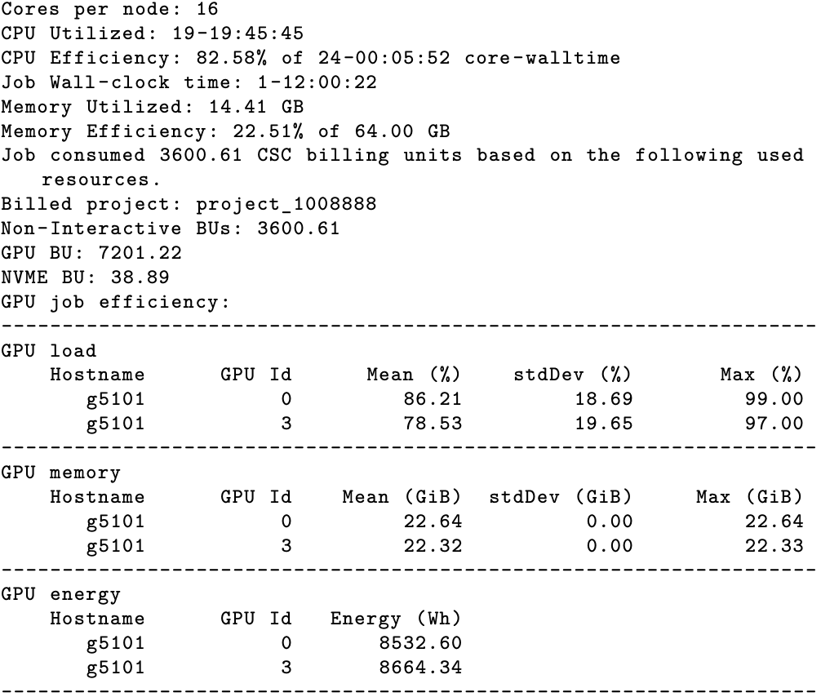
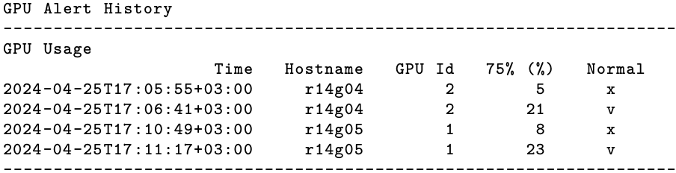
Modified Seff command
Perl script executed in the node to display job efficiency data in CLI
GPU job efficiency is displayed by URL calls to Timescale Reader
GPU alert history is displayed by URL calls to Timescale Alert
Notes:
To allow users to have access to the monitoring and alert data, we can use the API for Timescale Reader and Timescale Alert, and I also help develop and integrate them into various tools of the HPC computing environment at CSC to help understand and visualize them.
The seff command is a command line tool written in Perl to display job efficiency data. Aside from those data that are from Slurm, we modified the seff command with the GPU job efficiency data from Timescale Reader, which displays the mean, standard deviation, maximum value for GPU load and memory usage. We also provide the GPU energy usage for the whole job run.
The alert history is from Timescale Alert, which tells the time point when something might go wrong or return to normal regarding the GPU usage, which hopefully can help user debug their script and code.

Slide 17
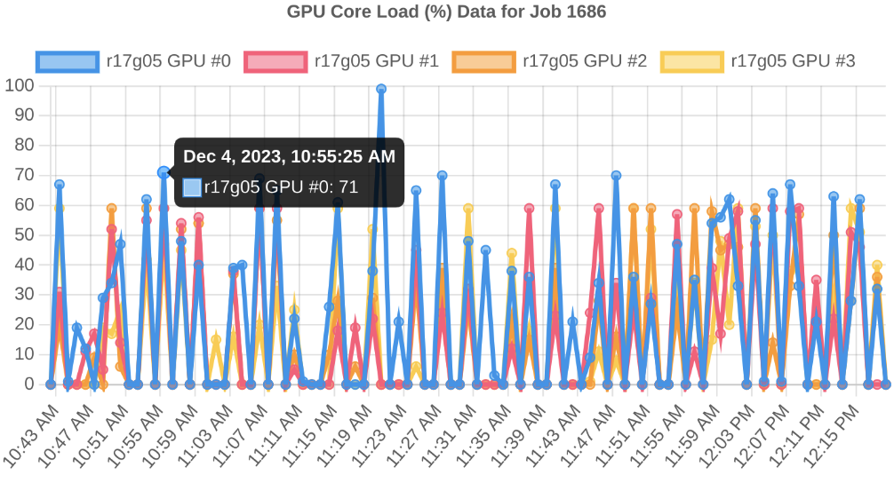
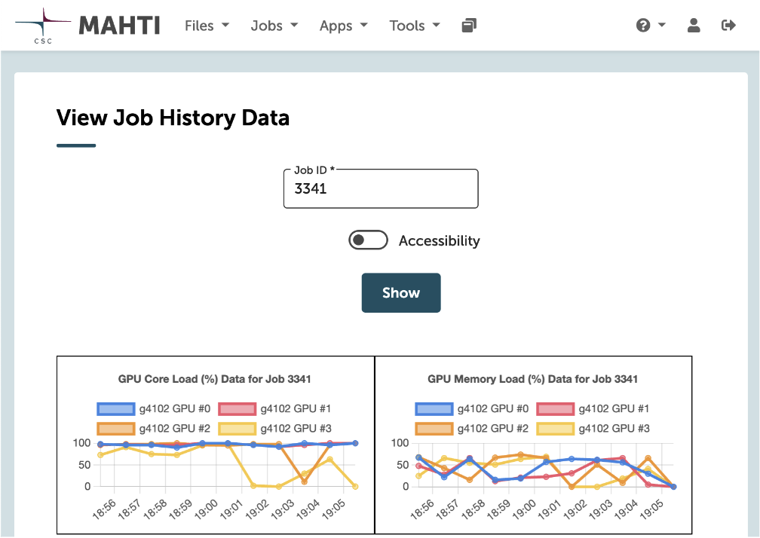
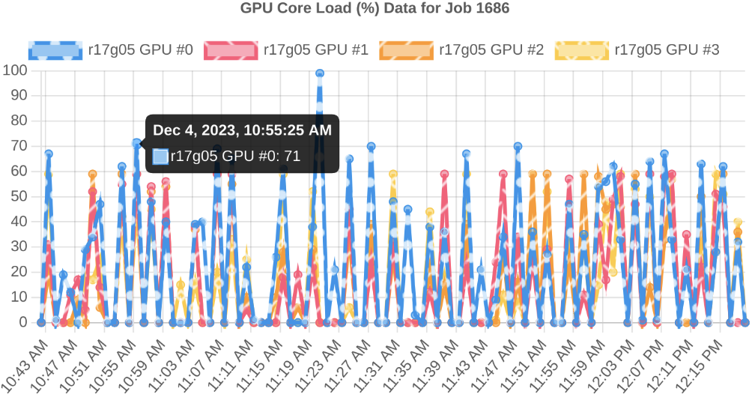
Job usage graph
Viewed from the Open OnDemand
Accessibility support
Notes:
We also have the job usage graph that is integrated into the open onDemand, which is the UI interface for HPC used at CSC. It shows the interactive history graph about the load, memory, power, and temperature. We also have the accessibility support with patterns and gradients to help viewers with vision deficiencies such as color blindness or partial sight more easily understand the data.

Slide 18
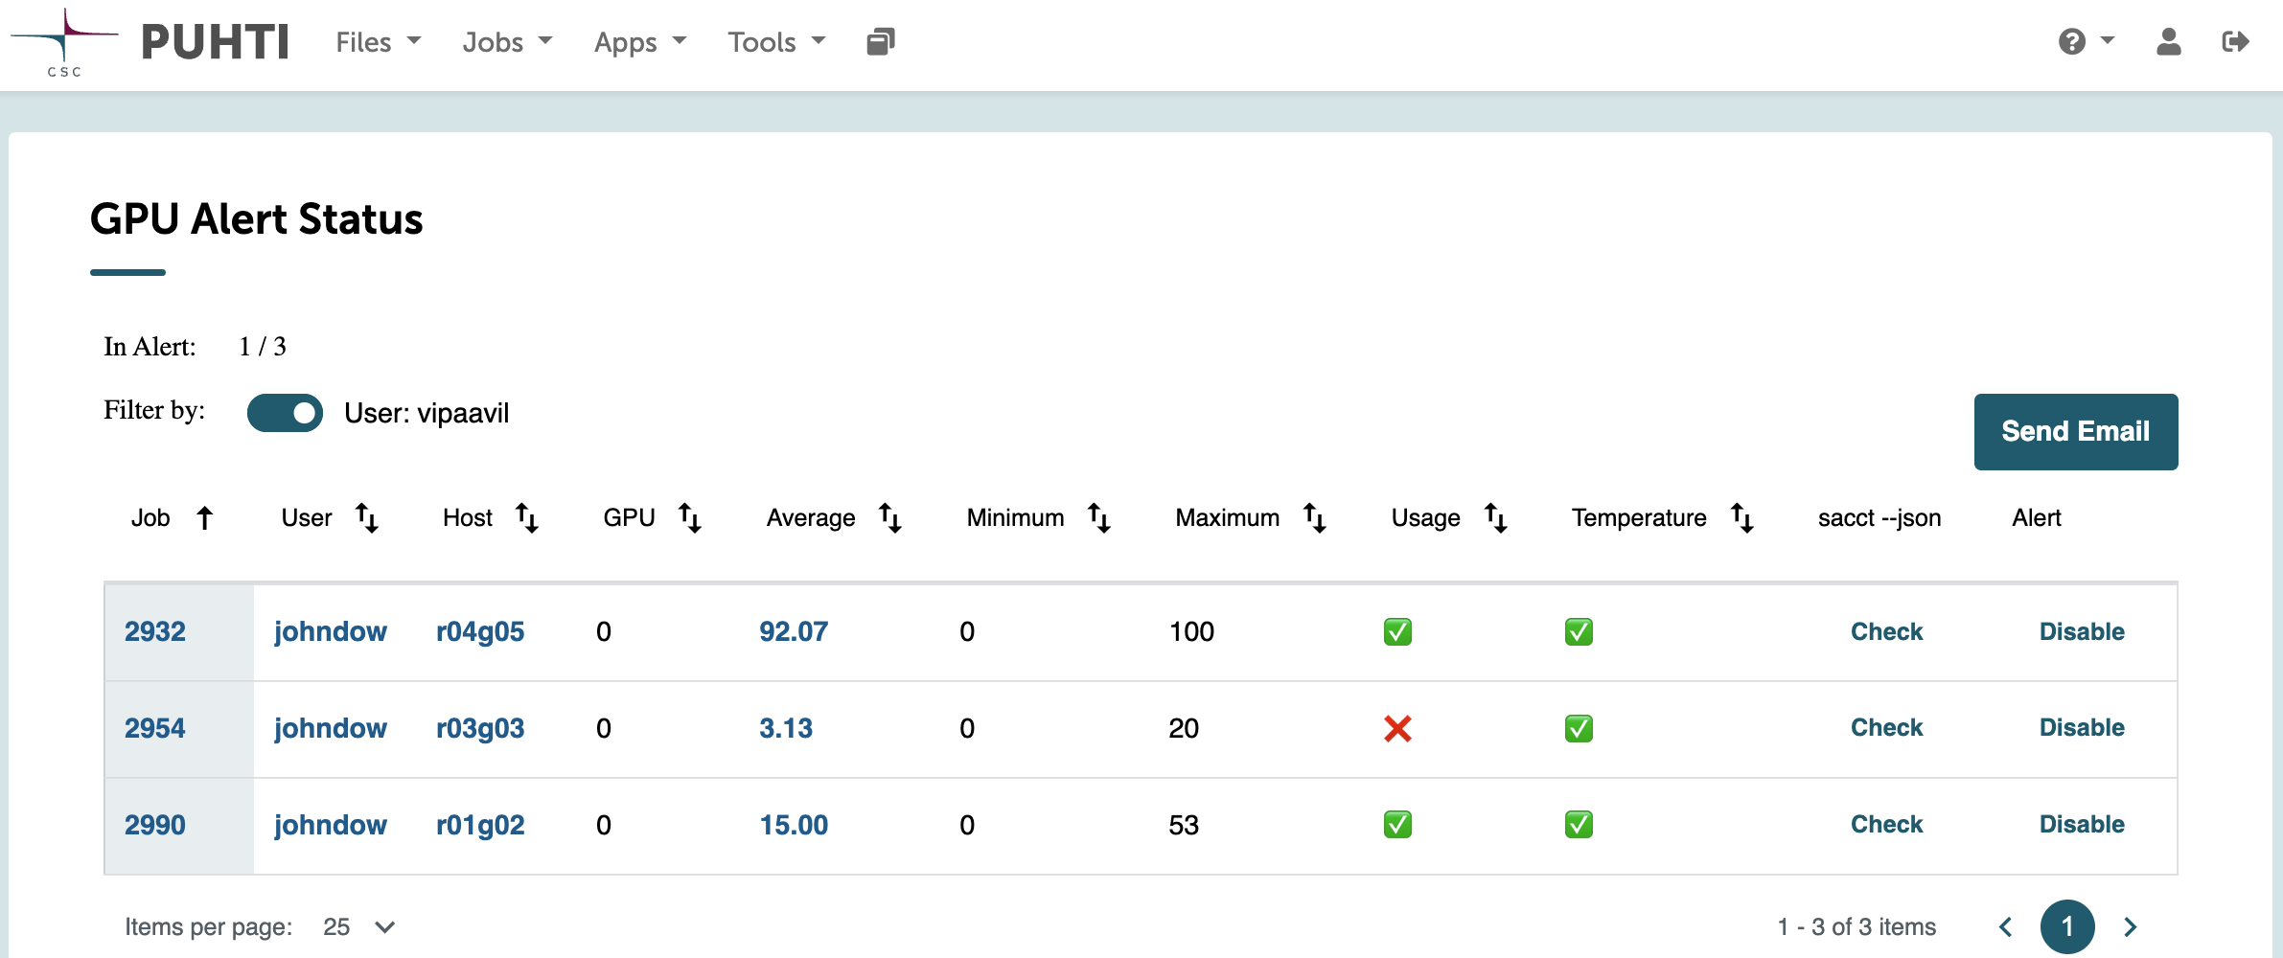
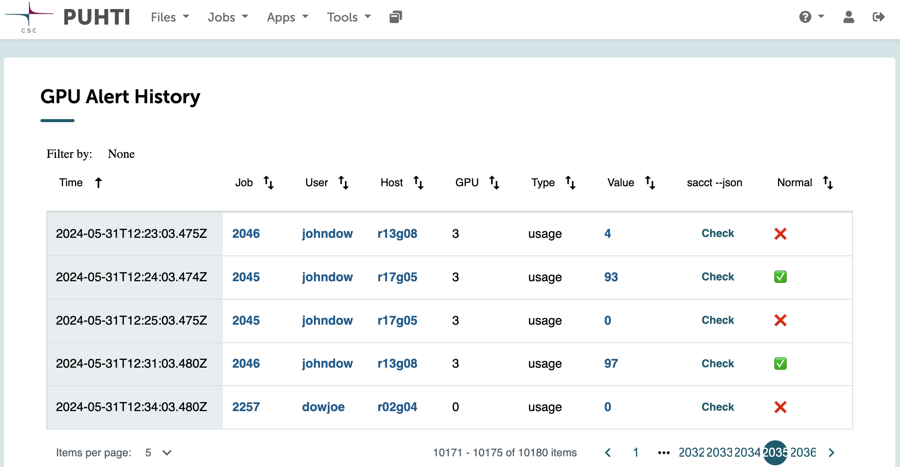
Alert dashboard
Display alert of GPU metrics for the job in a straightforward manner
Fetch data via RESTful API from Timescale Alert
Able to
Sort via values
Disable alert
Filter
Notes:
In addition, we have the alert dashboard to view the alert status and history, to give supercomputer administrators a better idea of what is going on and what has happened currently for all the GPU-related jobs in a straightforward manner. The data is fetched from Timescale Alert. In the alert status dashboard, each entry corresponds to a GPU used in a job. We can sort in decending or accending order for each column that have valid value in the table, we can also filter by job id, user name, and hostname. We can also view more detailed information in the dashboard with slurm command output. In the alert status dashboard, we can also disable alert, this can be useful when admin finds that it's a false alarm or the job is no longer in their interest.

Slide 19
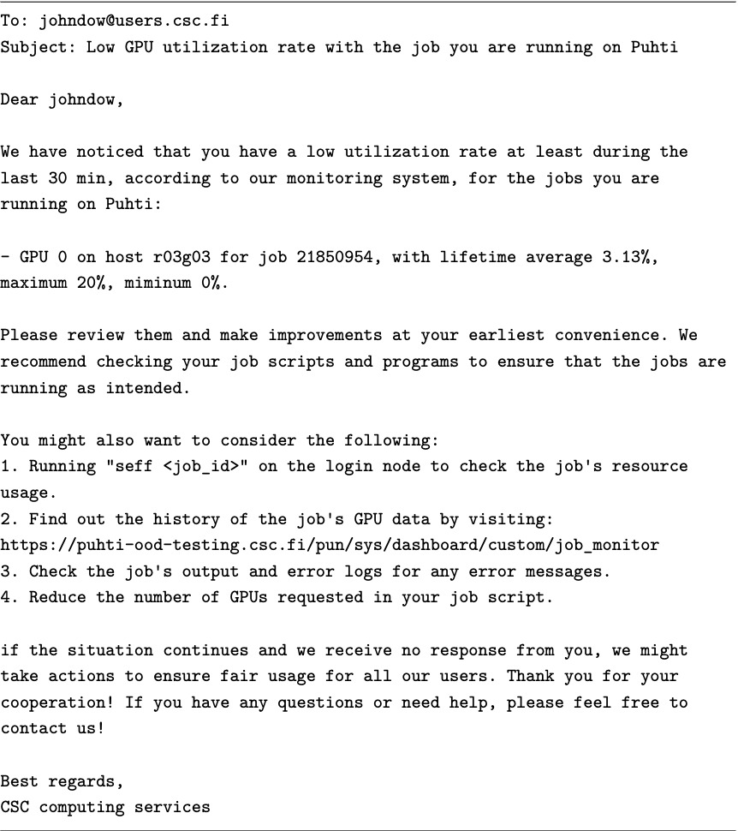
Alert dashboard
Generate the email automatically with a prefilled template
Send Email button when filtering by job ID or user name
Notes:
The alert dashboard also supports generating emails automatically to a specific user with a prefilled template, admins can do that when they filter the alert entries by job ID or user name.

Slide 20
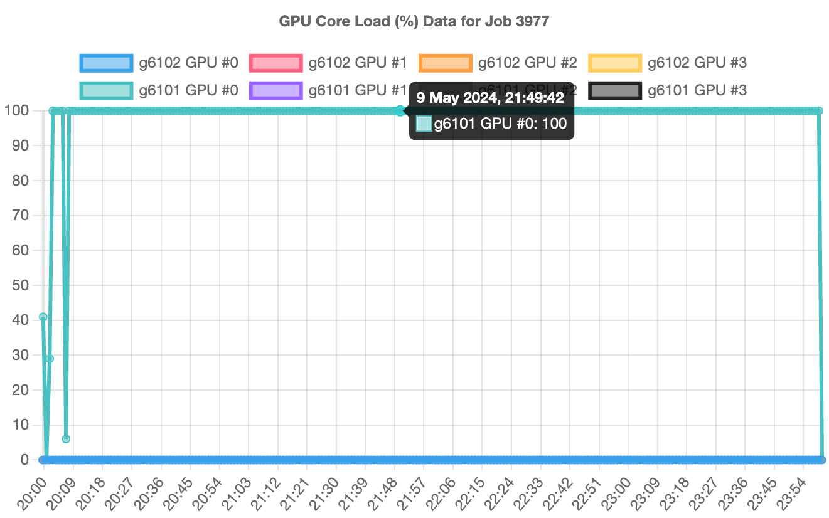
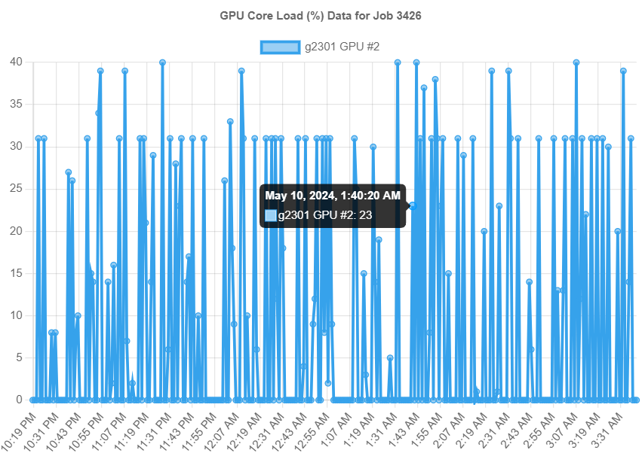
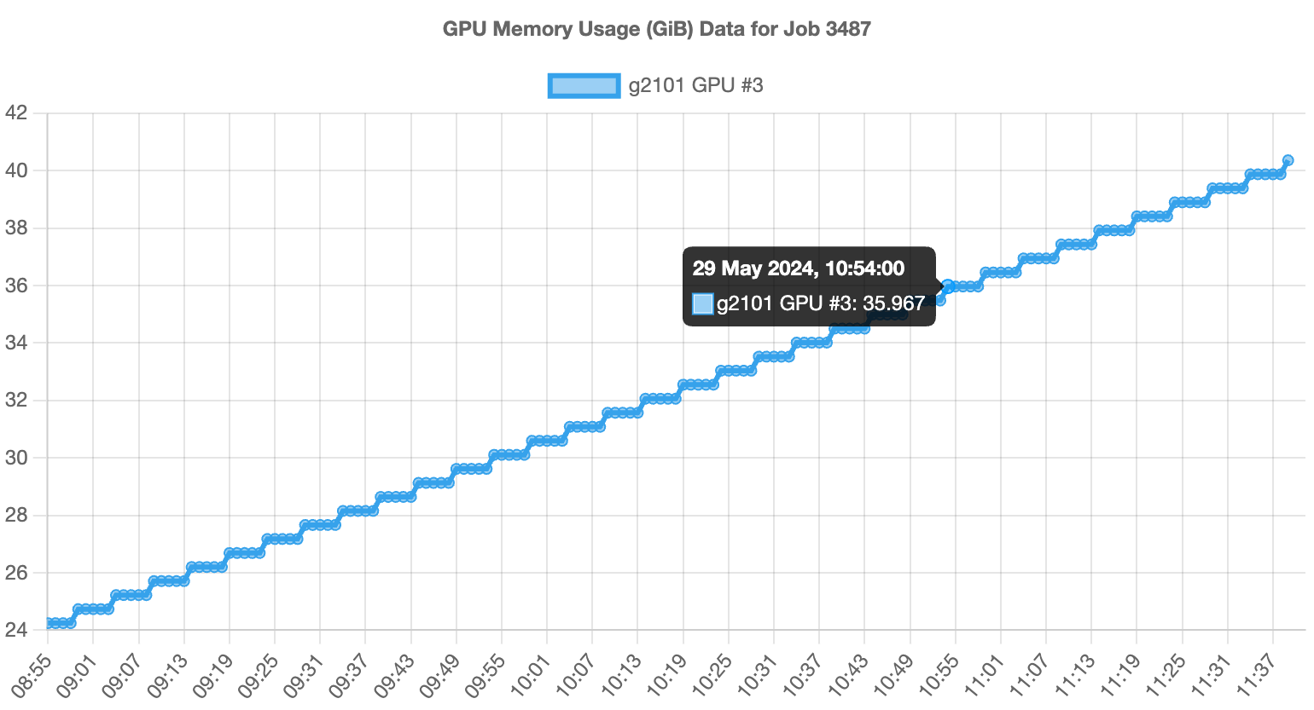
Case studies
High usage only on some GPUs:
Configuration Error
Code Bugs
Low usage on all GPUs
GPU Over-Provisioning
Interactive use on GPU compute mode
GPU OOM with gradual GPU memory increase
GPU Memory Leaks
Notes:
Here are some case studies for the real-world applications of the monitoring and alert service we have. When we found a job that only has some GPUs with high usage, and low or even 0 usage on the other GPUs, it's highly likely that the job has some configuration error or code bugs. If the job has low usage on all the GPUs allocated to it, then the user must have requested more GPUs than what is actually needed, or is interactively running the jobs, such as developing their code, on the GPU compute node. When we have GPU out of memory kill, and find a gradual GPU memory increase over a long period, it's likely that the code has memory leaks.

Slide 21
Future work
Integration with Additional Job Schedulers
LSF, TORQUE, UGE
More Monitoring Metrics
CPU, disk I/O, fine-grained GPU metrics
Flexible Alerting
Dynamic threshold according to workload type
Resource Optimization
History/Alert information for decision-making (e.g. autoscale)
Notes:
Due to the limited time and resources of this thesis, there are also several areas that are worth exploring as future work. Since now we only support slurm, it can also be interesting to integrate the monitoring and alerting infrastructure with additional job schedulers such as LSF. It might also be interesting to collect more monitoring metrics, such as CPU, and disk I/O as well as fine-grained GPU metrics, such as memory bandwidth, cache utilization, and instruction throughput. Hopefully, we can have a better alert algorithm if we can support dynamic threshold according to workload type, and possibly, we can also optimize resource allocation automatically through the history and alert to autoscale.

Slide 22
Thank you!
Notes:
That’s it, thank you for listening! If you have any questions, I’m happy to answer them now.

Slide 23
Solution 1: Polling with Cagg
SELECT time_bucket(INTERVAL '30 seconds', timestamp) AS bucket,host,gpu,job,AVG(load_gpu) AS load_gpu,AVG(load_memory) AS load_memory,AVG(used_mem) AS used_mem,AVG(power) AS power,AVG(temperature) AS temperature FROM gpu_usage GROUP BY bucket, host, gpu, job;
SELECT add_continuous_aggregate_policy('gpu_usage_aggregate',start_offset => INTERVAL '1 minute',end_offset => NULL,schedule_interval => INTERVAL '1 seconds');
Start/Stop polling as soon as job metadata updates
Performance: 28s write delay, 10min+ for completing a read loop

Slide 24
Solution 2: Polling without Cagg
SELECT AVG(load_gpu), AVG(load_memory), AVG(used_mem), AVG(power), AVG(temperature), MAX(timestamp) FROM (SELECT load_gpu,load_memory,used_mem,power,temperature,timestamp FROM gpu_usage WHERE host=%v AND gpu=%v AND job=%v ORDER BY timestamp DESC LIMIT %v) AS history;
Start/Stop polling as soon as job metadata updates
Performance: 23s write delay, 20min+ for completing a read loop

Slide 25
Solution 3: Triggers with Cagg
PERFORM pg_notify('gpu_usage_insertion', (NEW.host || ',' || NEW.gpu || ',' || NEW.job)::text);
SELECT load_gpu,load_memory,used_mem,power,temperature FROM gpu_usage_aggregate WHERE host=%v AND gpu=%v AND job=%v ORDER BY bucket DESC LIMIT 1;
Query according to the information sent by the NOTIFY as soon as the message is received
Performance: 52s write delay, 200ms for completing a dump loop, near real-time updates (depends on the background job speed)

Slide 26
Solution 4: Triggers without Cagg
PERFORM pg_notify('gpu_usage_insertion', (NEW.host || ',' || NEW.gpu || ',' || NEW.job || ',' || NEW.load_gpu || ',' || NEW.load_memory || ',' || NEW.used_mem || ',' || NEW.power || ',' || NEW.temperature)::text);
Use container/ring (Circular Linked List) to store the history data
Do the aggregation by Golang
Performance: 39s write delay, 600ms for completing a dump loop, near real-time updates (depends on the background job speed)

Slide 27
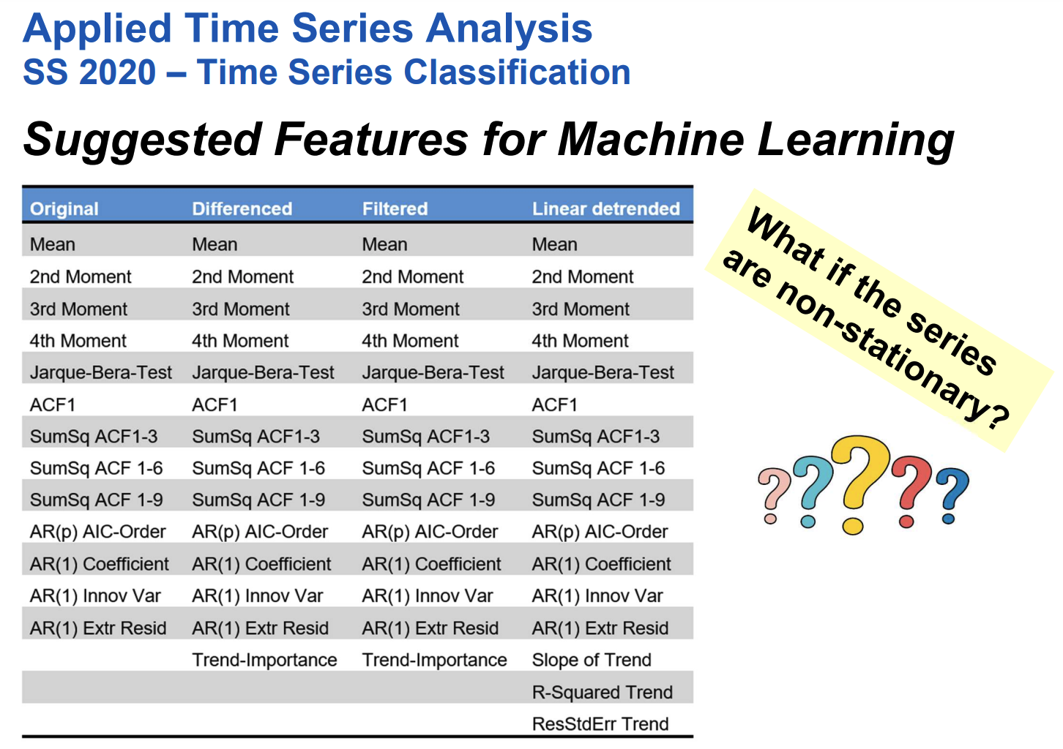
Notes:
This is a slide taken from a ETH Zurich course which shows the suggested feature for time series features that can be used for machine learning in our case.

